Slide 1

Does LA city employee compensation align with current housing price trend
Team:
Susan Quiros,
Elijah Abuel
Harika Peddiraju
Mohan Panga

Slide 2
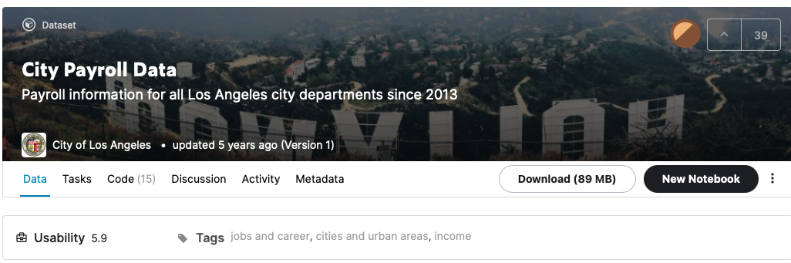
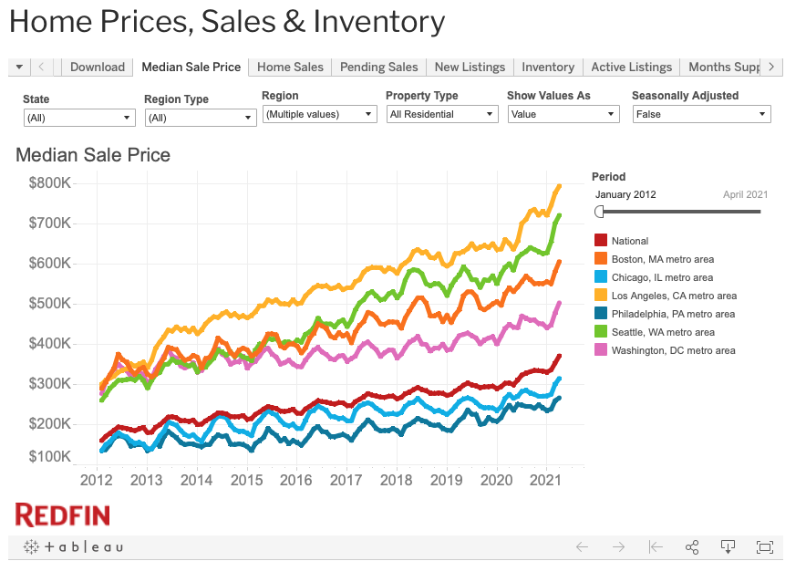
Data Sets
Kaggle: Los Angeles Public Sector Salaries
https://www.kaggle.com/cityofLA/city-payroll-data
Redfin: Housing Prices in LA
https://www.redfin.com/news/data-center/

Slide 3
Approach
Data Cleaning & Preparation
Filter top 4 departments based on number of records
Analyzed top 4 job titles in the selected departments
Housing price
vs
Salary trends
Drop NA & missing values
Data Typecasting
58 total departments
Selected:
Fire
Police
Airport
Water & Power
~ 100-325 job titles per department
Analyzed 2013, 2014, 2015
base pay
total payments
benefit cost
% increase in housing price vs. base pay for selected job titles

Slide 4
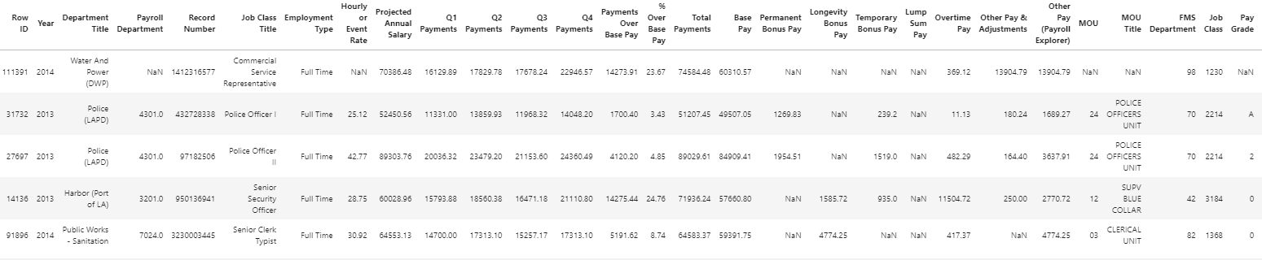
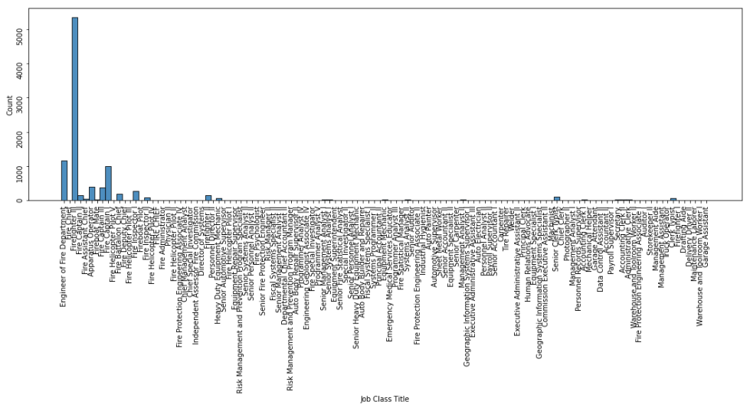
Data Overview
285008 records ✕ 36 fields
e.g. Job class titles in Fire Safety department

Slide 5
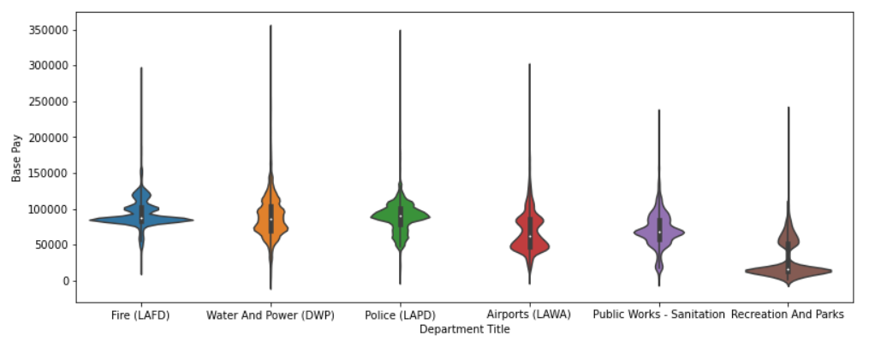
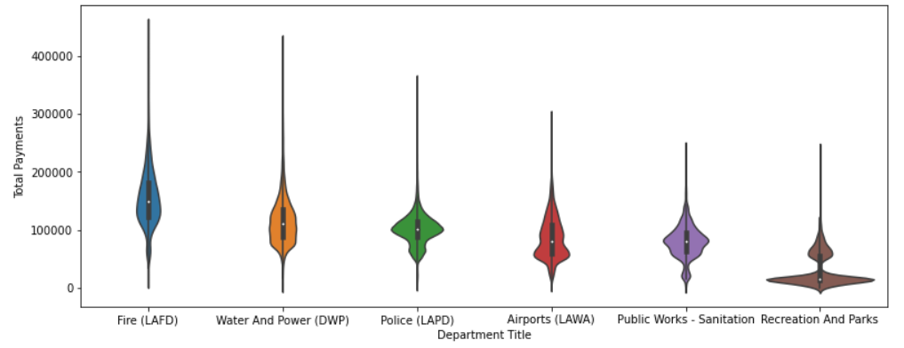
6 Departments
Outlier data in each category
Only selected top 4 job class titles by number of records.

Slide 6
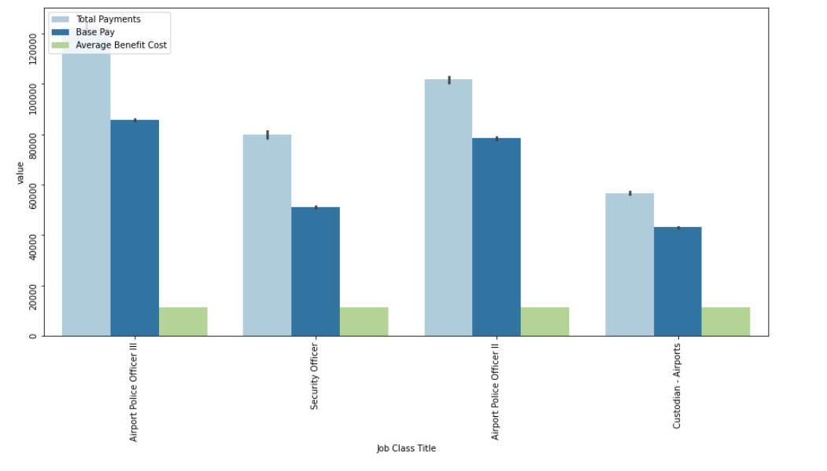
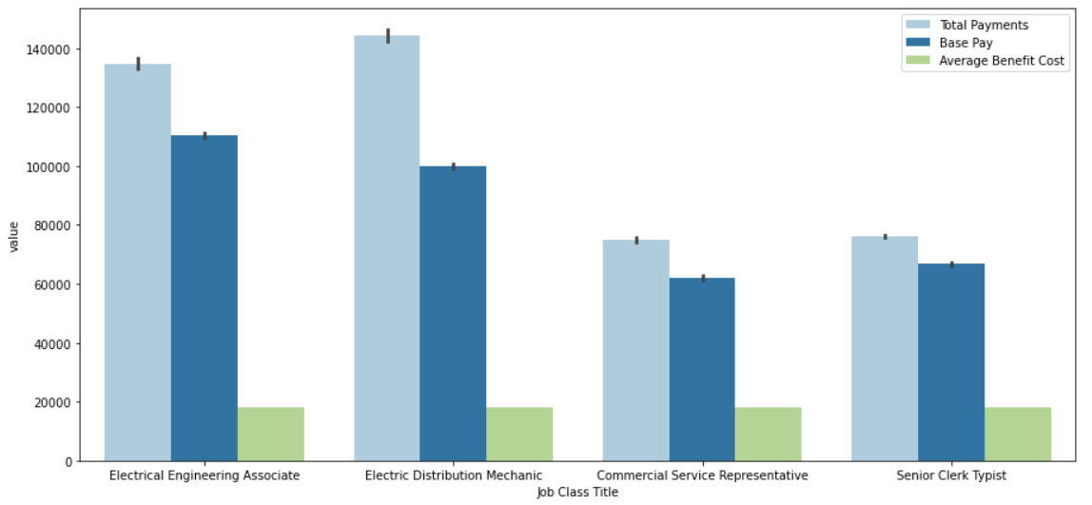
Salary Breakdown Overview
Airports
Police
Fire Safety
Water & Power

Slide 7
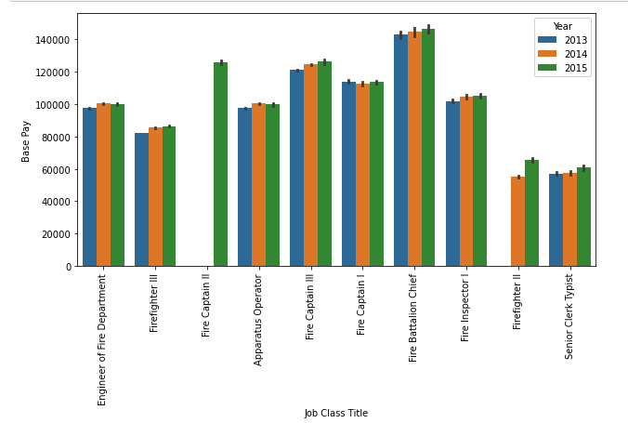
Salary Growth
Airports
Police
Fire Safety
Water & Power

Slide 8
Housing

Slide 9
Compare Housing To Salary

Slide 10
Conclusion

Slide 11
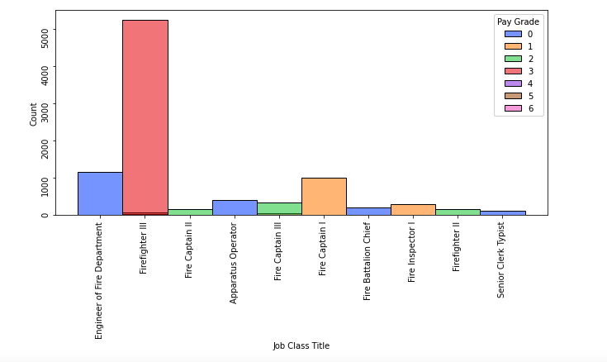
Job Titles: Filtered

Slide 12
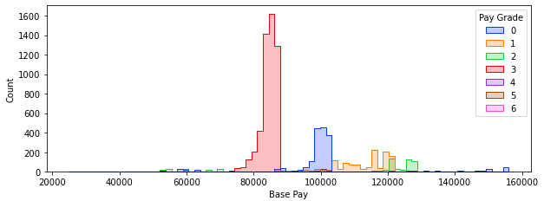
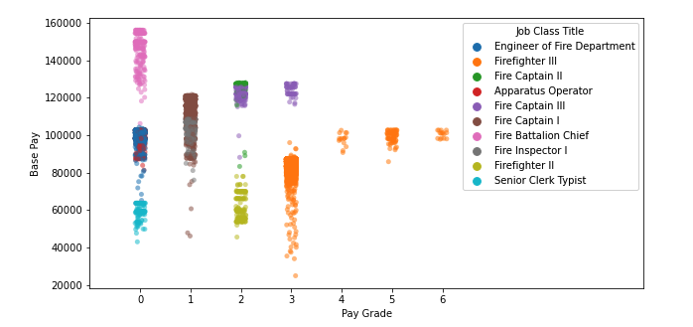
Base Pay based on Pay Grade

Slide 13
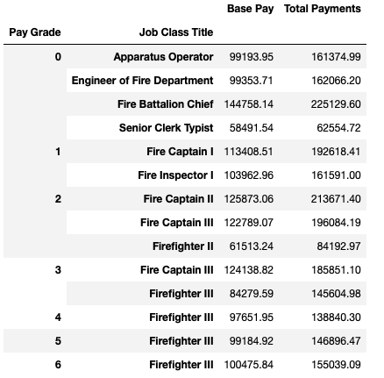
Base Pay per Job Class

Slide 14
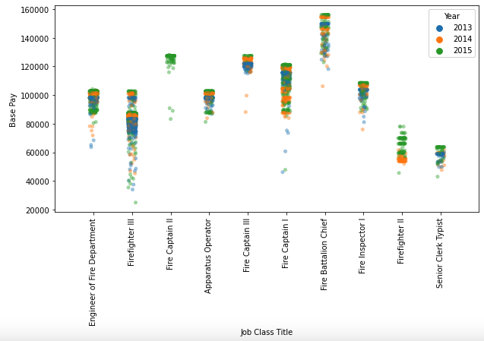
Yearly Data

Slide 15
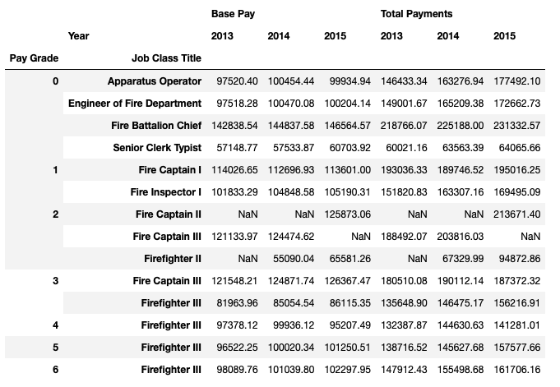
Data Summary

Slide 16

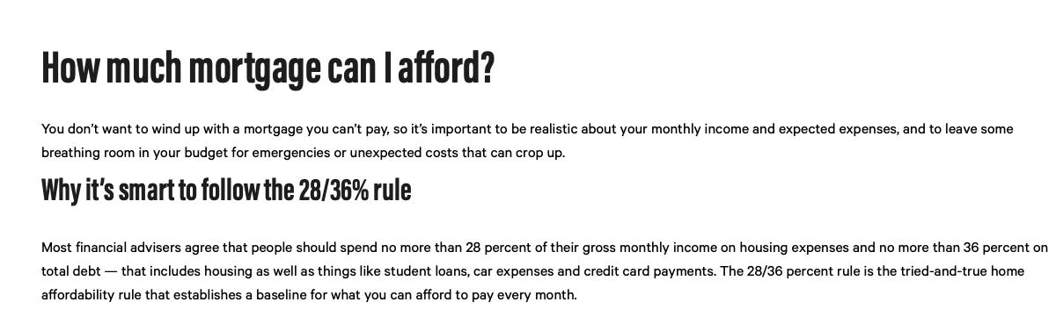
House affordability

